Slide 1
Corning Incorporated
Research Report Demo Presentation
Candidate: Christopher VanDemark
Position: Statistical Engineer 54440

Slide 2
Scientific Problem
A cancer research facility is trying to better understand what causes advanced prostate cancer. Prior research shows that prostate cancer is correlated with Prostate-Specific Antigen (PSA), an enzyme the builds up in the prostate gland. The research facility has contacted myself requesting statistical consulting on new data collected through a university medical center.
Their goal is to better understand the relationships between their selected independent variables and their dependent variable, PSA. Using the findings of this research the facility wants to use it as a basis for further data collection and scientific research.
The research has been completed and prepared for final presentation.

Slide 3
Outlook
Research Question
Data Review
Methodology
Hypothesis
Statistical Analysis (Distribution, Outliers, Multicollinearity, Model Selection)
Hypothesis Test
Summary

Slide 4
Research Question
What measured variables among patients diagnosed with advanced prostate cancer have a statistical relationship with Prostate-Specific Antigen?

Slide 5
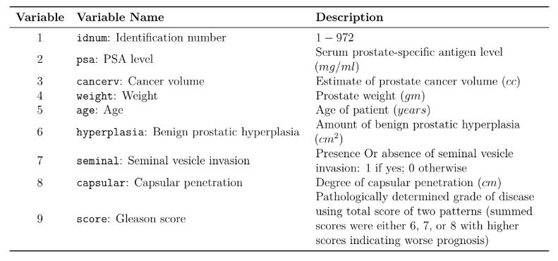
Data (Variables)
Source: Hastie, T. J.; R. J. Tibshirani; and J. Friedman. The Elements of
Statistical Learning: Data Mining. Inference. and Prediction. New York: Springer-Verlag, 2001.

Slide 6
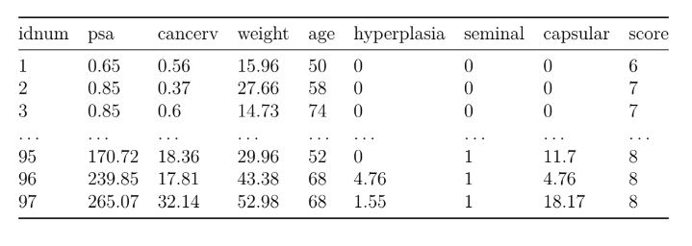
Data (Format)
Source: Hastie, T. J.; R. J. Tibshirani; and J. Friedman. The Elements of
Statistical Learning: Data Mining. Inference. and Prediction. New York: Springer-Verlag, 2001.

Slide 7
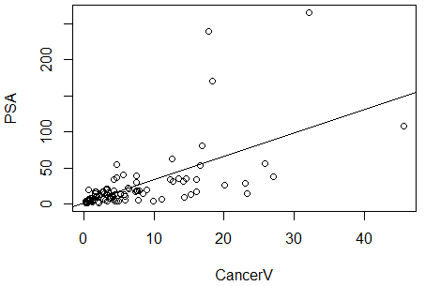
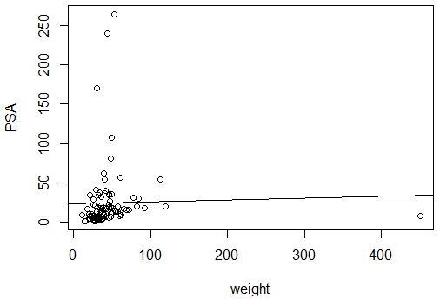
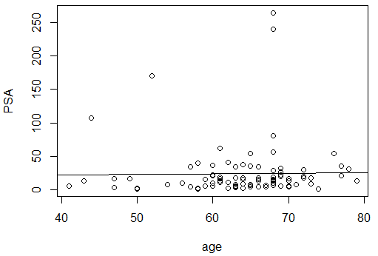
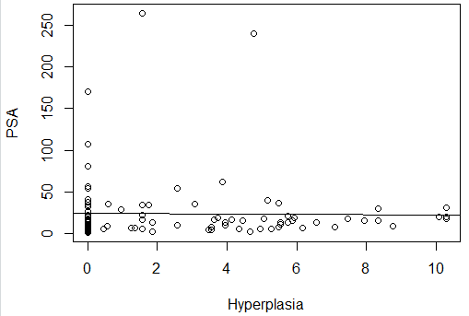
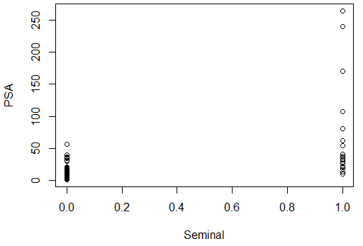
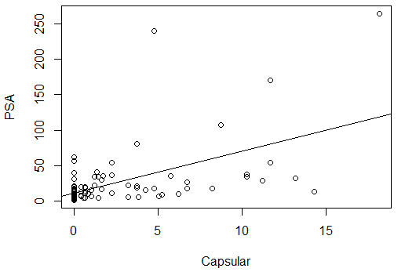
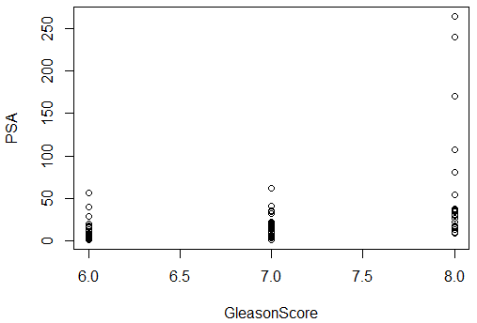
Methodology
Multiple Linear Regression research design
Dependent Variable is Continuous (quantitative)
Natural linear relationship among variables

Slide 8
Hypothesis
Our hypothesis is a proposed relationship between the response (dependent) variable, PSA, and the predictor (independent) variables
A hypothesis has a null and an alternative
Null Hypothesis: there is no relationship between the response and predictors
Alternative Hypothesis: there is a relationship between the response and predictors
Null ⇒ H₀ ⇒ β_{i} = 0
Alternative ⇒ H_{𝞪} ⇒ β_{i} ≠ 0
Where:
β: The correlation coefficient of the predictor variable in our model
i: Denotes the predictor variable

Slide 9
Assumptions
Linear relationship between response and predictors
Normal distribution
Boxplots
Alternative: QQ-Plots
Lack of multicollinearity
Correlation Matrix
Variance Inflation Factor (VIF)
Variance is constant
Plotting residuals of our model

Slide 10
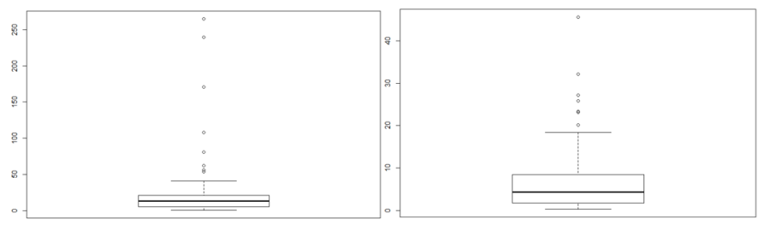
Boxplots
Prostate-Specific Antigen
Cancer Volume
PSA: Skewed right; presence of outliers
Cancer Volume: Skewed right; presence of outliers

Slide 11
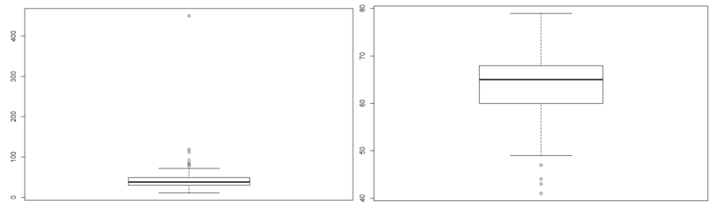
Boxplots
Weight
Age
Weight: Normal; presence of outliers
Age: Normal; presence of outliers

Slide 12
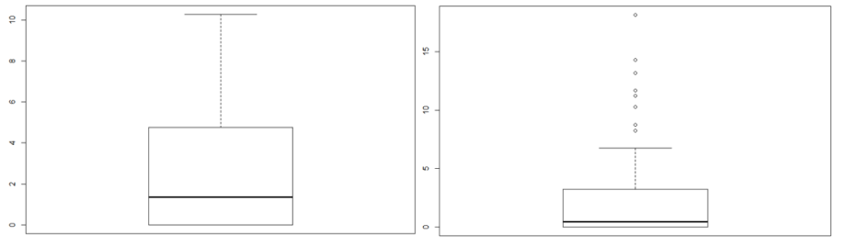
Boxplots
Hyperplasia
Capsular
Hyperplasia: Skewed Right; presence of outliers
Capsular: Skewed right; presence of outliers

Slide 13
Multicollinearity
Occurs when two or more predictor variables are highly correlated with one another
Damages model performance
Misleading final results
Tests for multicollinearity:
Correlation Matrix
Variation Inflation Factor (VIF)

Slide 14
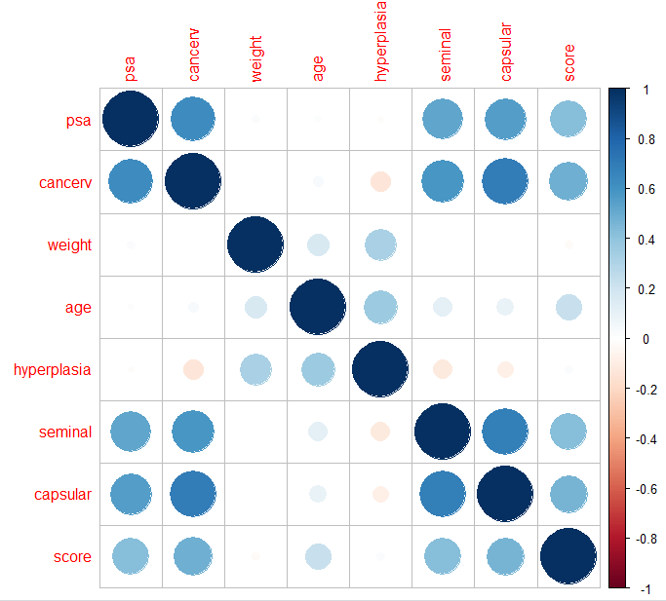
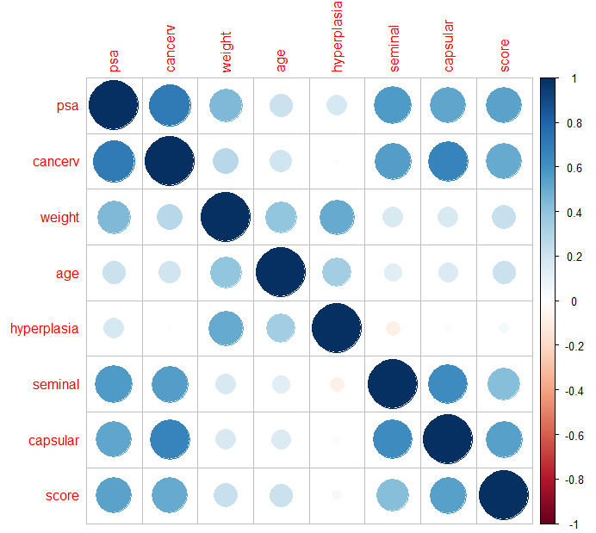
Correlation Matrix
Pearson
Spearman

Slide 15
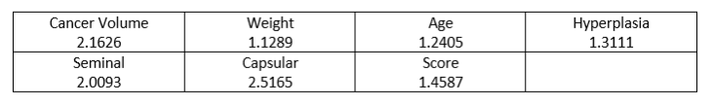
Variation Inflation Factor
Test statistic that signals multicollinearity when a variables VIF is greater than 5

Slide 16
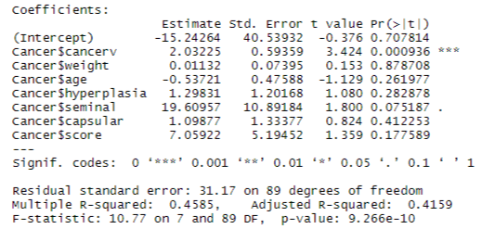
Full Model
PSA = β₀ ± β₁(CancerV) ± β₂(Weight) ± β₃(Age) ± β₄(Hyperplasia) ± β₅(Seminal) ± β₆(Capsular) ± β₇(Score) ± e
Predictor | β | P-value
CancerV | 2.03 | <0.000
Weight | 0.01 | 0.879
Age | -0.54 | 0.262
Hyperplasia | 1.30 | 0.283
Seminal | 19.61 | 0.075
Capsular | 1.10 | 0.412
Score | 7.06 | 0.178

Slide 17
Model Reduction and Selection
Mallows Cp
Accounts for bias in a model
Select a model with a Cp value smaller than the number of variables (k) plus the constant in the model
Bayesian Information Criterion (BIC)
Signals predictive power of a model
Select a model based on the lowest BIC
Adjusted R-squared
Penalizes models for having too many variables
Select a model based on the highest value (range is from [0,1])

Slide 18
Model Reduction Results
Model | Mallows Cp | BIC
Cancer | 7.34 | -38.72
Cancer+Seminal | 2.53 | -40.96
Cancer+Seminal+Score | 2.64 | -38.37
Cancer+Seminal+Score+Hyper | 3.92 | -34.55
Cancer+Seminal+Score+Hyper+Age | 4.7 | -31.29
Cancer+Seminal+Score+Hyper+Age+Cap | 6.02 | -27.45
Cancer+Seminal+Score+Hyper+Age+Cap+Weight | 8.00 | -2.90
We choose the second model (Cancer and Seminal Invasion) based on Mallows Cp and BIC
Adjusted R-square results showed no significant difference between models 3, 4, and 5

Slide 19
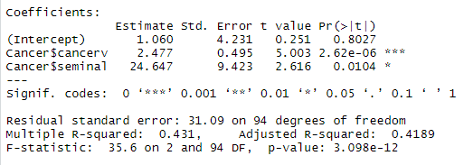
Final Model
PSA = β₀ ± β₁(CancerV) ± β₂(Seminal) ± e
Predictor | β | P-value
CancerV | 2.48 | <0.000
Seminal | 24.65 | 0.0104
PSA = 1.060 + 2.48(CancerV) + 24.65(Seminal)

Slide 20
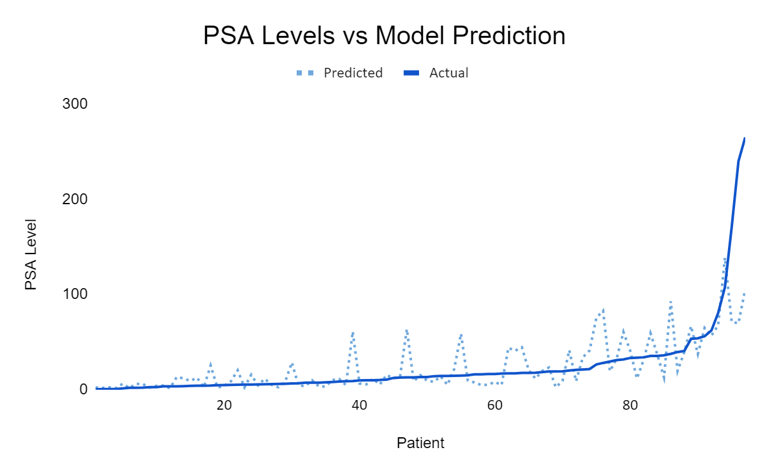

Slide 21
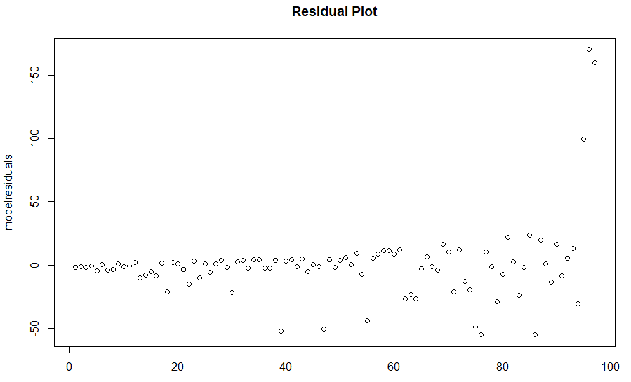

Slide 22
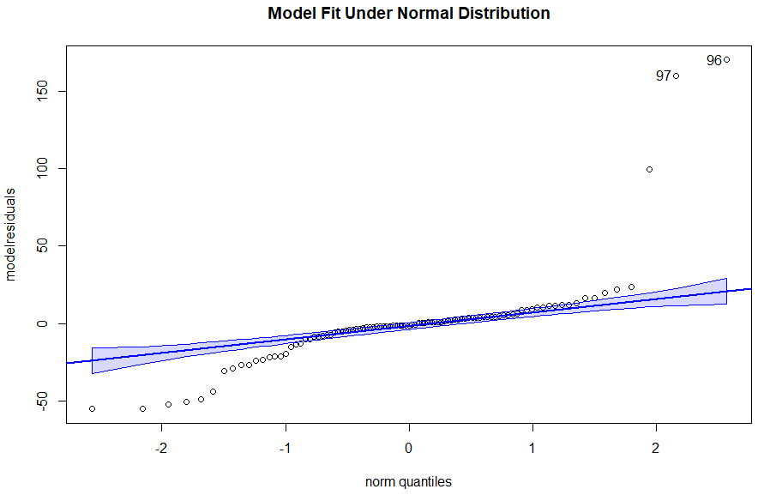

Slide 23
Hypothesis Test
T-test statistic method
Calculated as t* using statistical software
Each variable in a final model needs a t* calculated
Decision Rule:
If ⇒ t* > t(1 - 𝞪/2, degrees of freedom), then ⇒ reject the null H₀
“t(1 - 𝞪/2, degrees of freedom)” comes from t-distribution, calculated using statistical software
𝞪 = 0.05, with 95 degrees of freedom
Predictor | t*
CancerV | 5.00
Seminal | 2.62
t-distribution
1.99
t* > 1.99; reject the null hypothesis in favor of the alternative H_{𝞪} ⇒ β_{i} ≠ 0

Slide 24
Summary
Statistically significant predictors of PSA:
Cancer Volume: predict a 2.48 increase in PSA when cancer volume increases by 1cc
Seminal Invasion: predict a 24.65 increase in PSA when there is presence of seminal invasion
Poor adjusted R-squared (how well the model explains variance in PSA)
Alibi: lack of successful research and predictability of cancer in general
All other variables were shown to be statistically insignificant and have no relationship with PSA levels
Presentation and all supporting statistical work is available to the public at:
https://github.com/cvandemark

Slide 25
Questions?

Slide 26
Thank you!
Presenter: Christopher VanDemark
Cell: (607) 329-7905
Email: cvandemark@kumc.edu
Special thanks to:
Dr. Mihaela Sardiu
Associate Professor KUMC, Biostat Faculty
Email: msardiu@kumc.edu
Dr. John Keighley
Associate Professor KUMC, Biostat Faculty
Email: jkeighley@kumc.edu

